Slide 1
Hair Salon Employee Database
By: Josh Alberti, Tai Pham

Slide 2
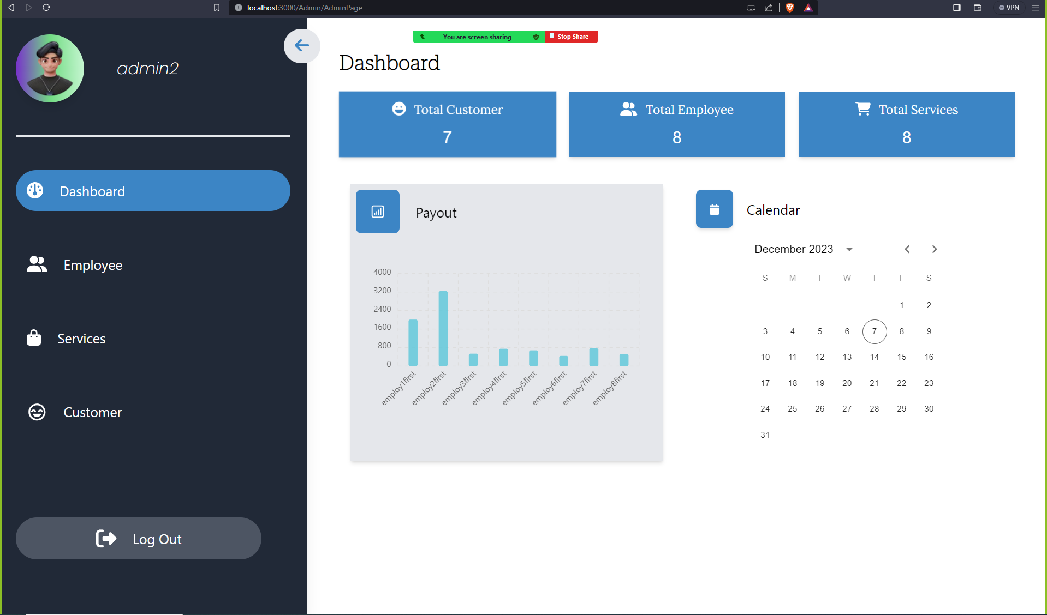
System description
Allows for keeping track of personal employee and customer information as well as pay calculations and order amount/popularity all on an easy to use informative website

Slide 3
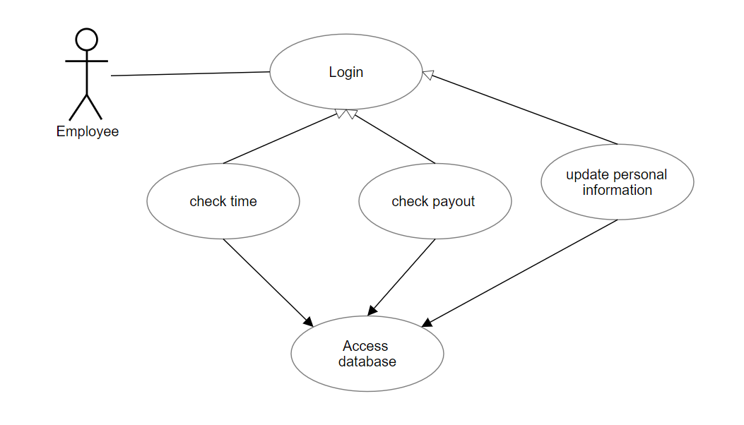
Our first use case is from the perspective of the employee of a hair salon. They would be able to login in to an account and then access their specific data in order to check up on how they are doing, time worked/expected payout and edit any person information that is out of date such as address, contact number, etc.

Slide 4
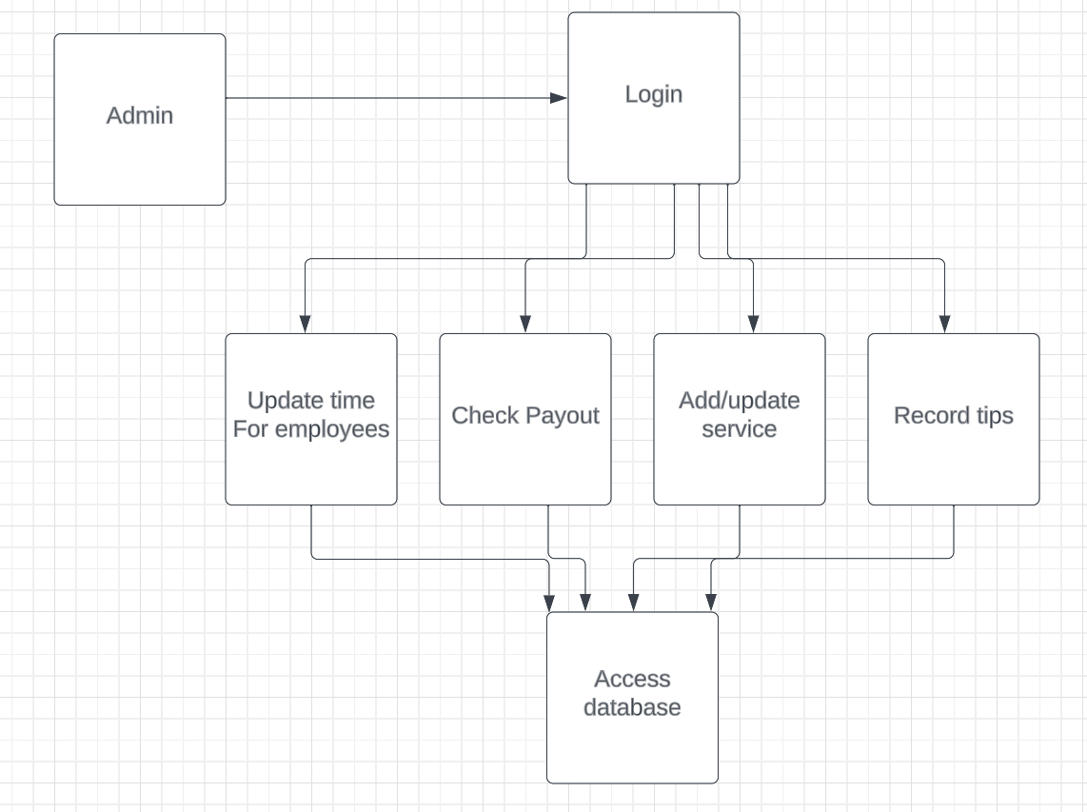
Our second use case is from and admin which could be a database manager or just a shift manager or whatnot. They would have to be able to update the time worked for all employees and and check how much they would be paid according to the calculation as well as check certain personal information. All of this should be in friendly ui so as not to confuse people without technical background

Slide 5
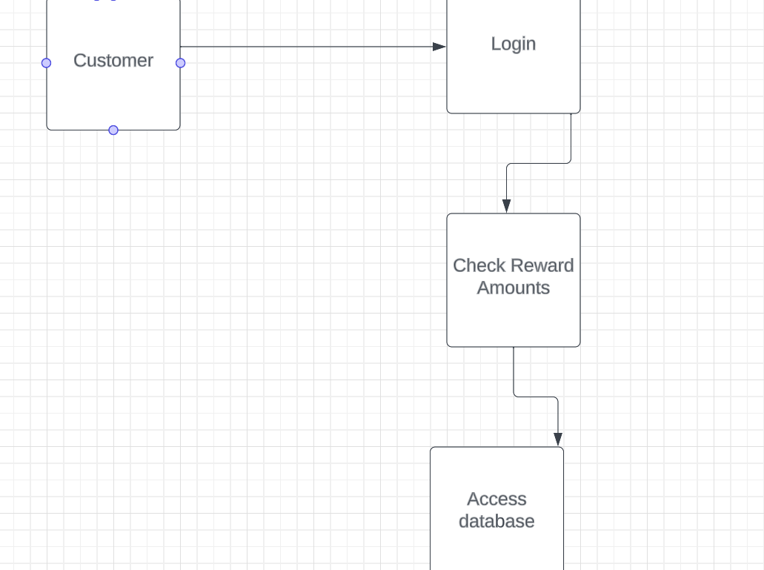
Our third use case centers around the customer accessing the website in order to check on their reward points

Slide 6
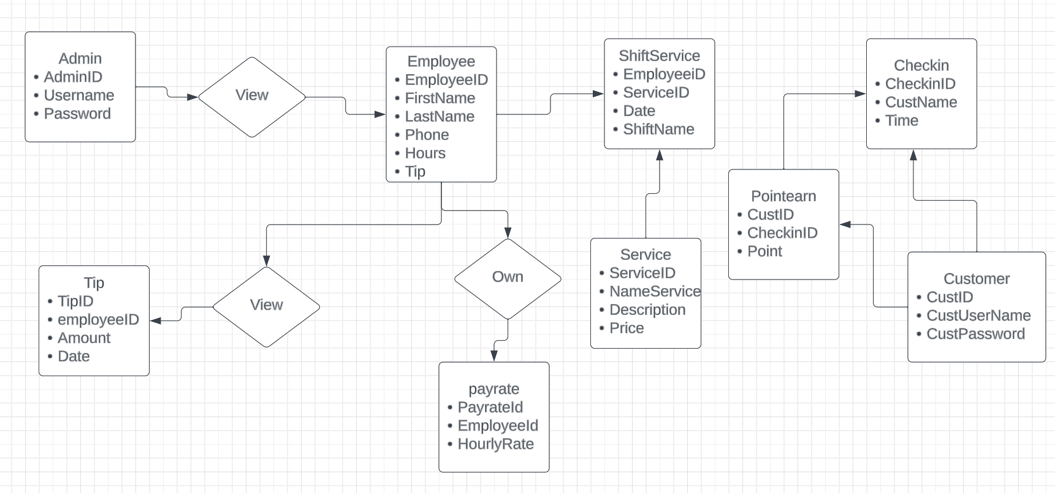
E/R Diagram

Slide 7
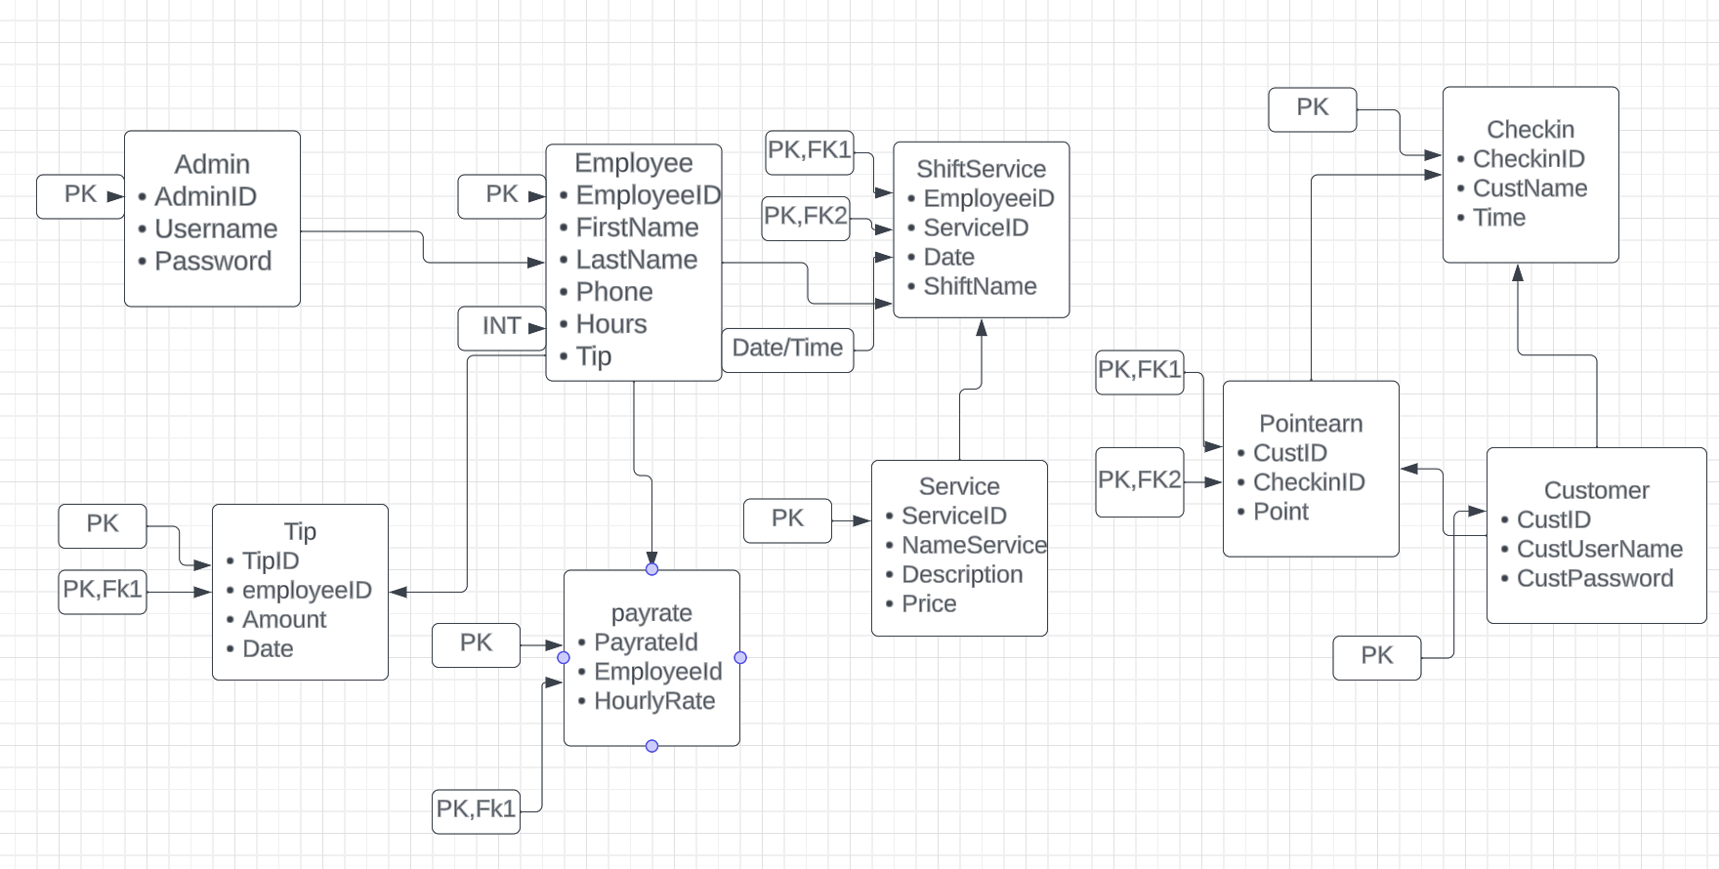
Table

Slide 8



Implementation Details
Front End:
We use React
Back End:
Python
Mysql for database management

